Slide 1
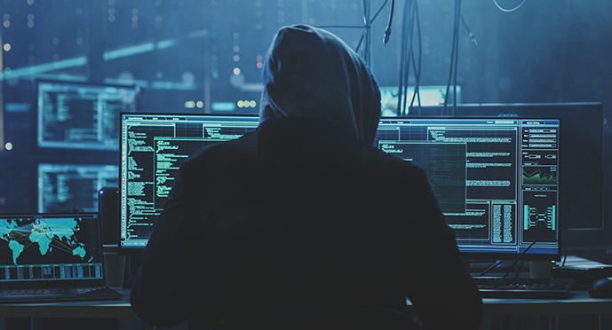
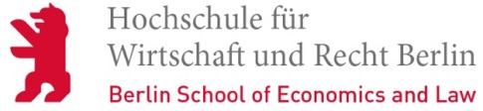
Security – Session 1: Introduction
Prof. Dr.-Ing. Sebastian Schlesinger
Professor of Business Computer Science (Infrastructure & Security)

Slide 2
IT Security
“Why is IT security even relevant? ”

Slide 3
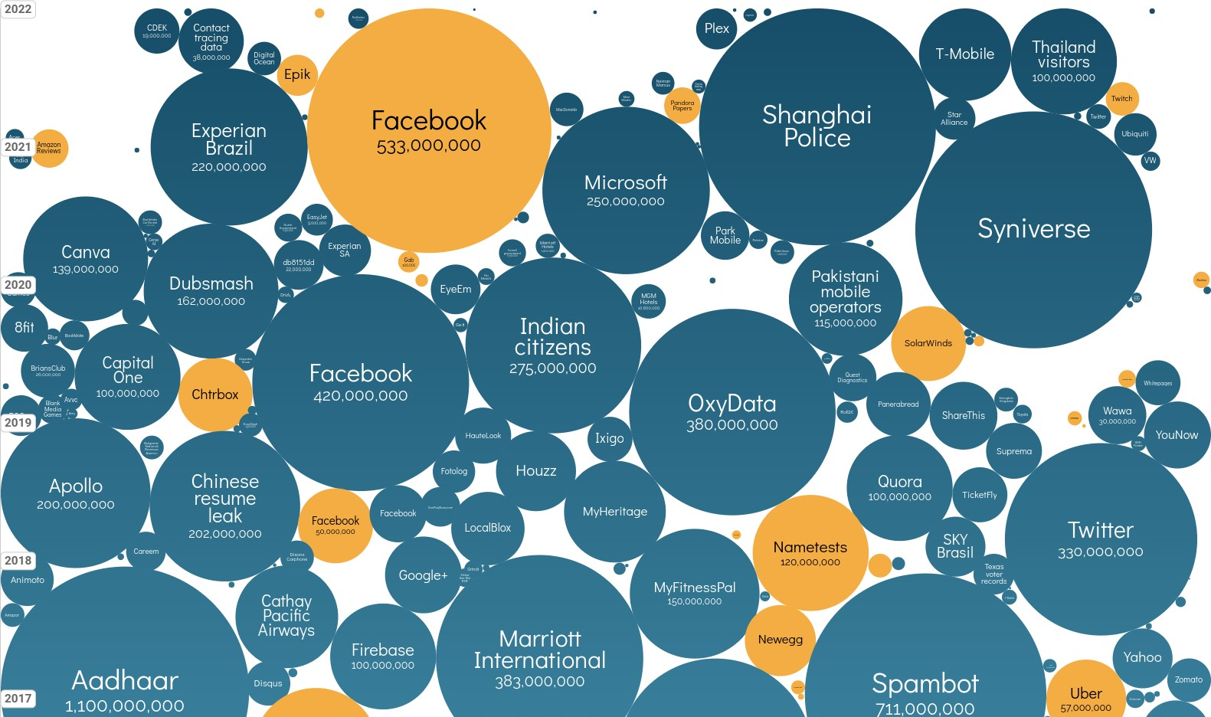
World’s biggest data breaches and hacks
Source: https://informationisbeautiful.net/visualizations/worlds-biggest-data-breaches-hacks/

Slide 4
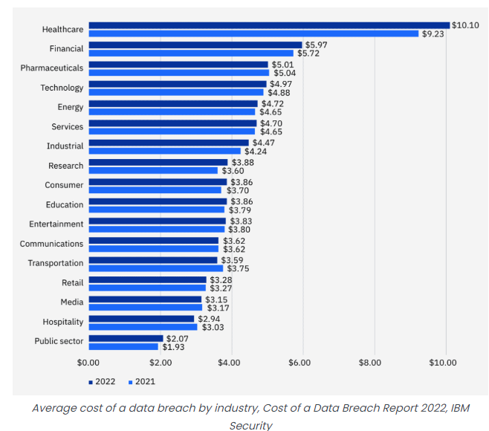
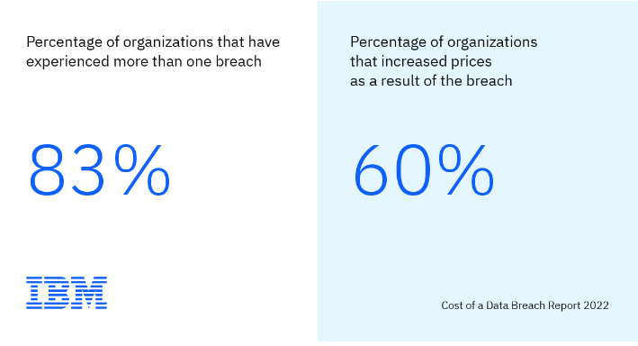
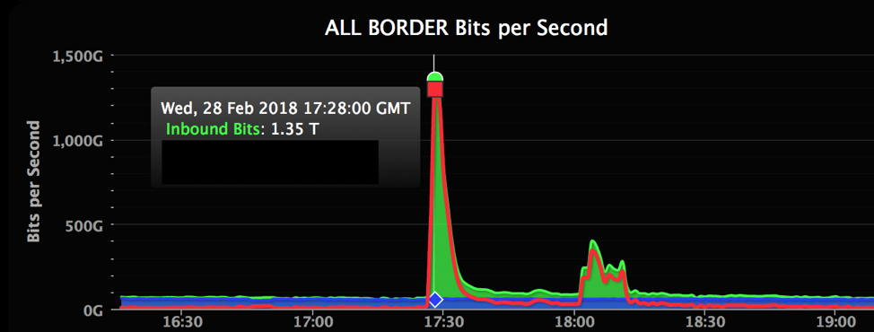
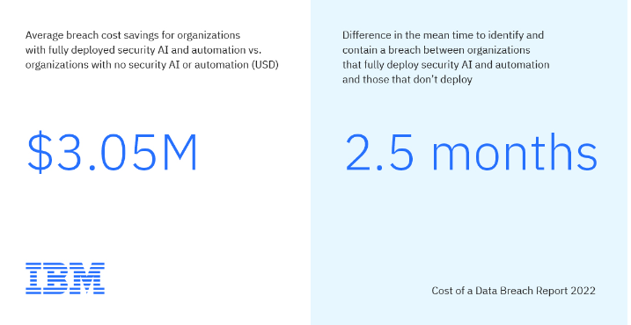
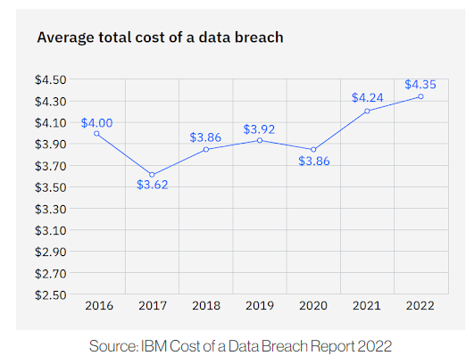
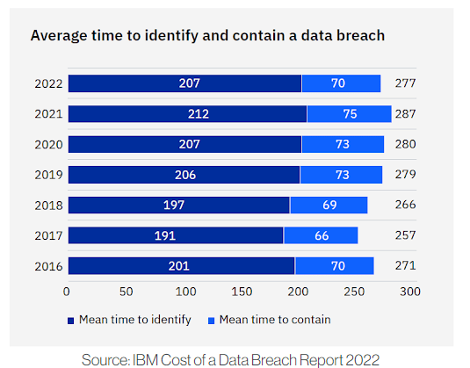
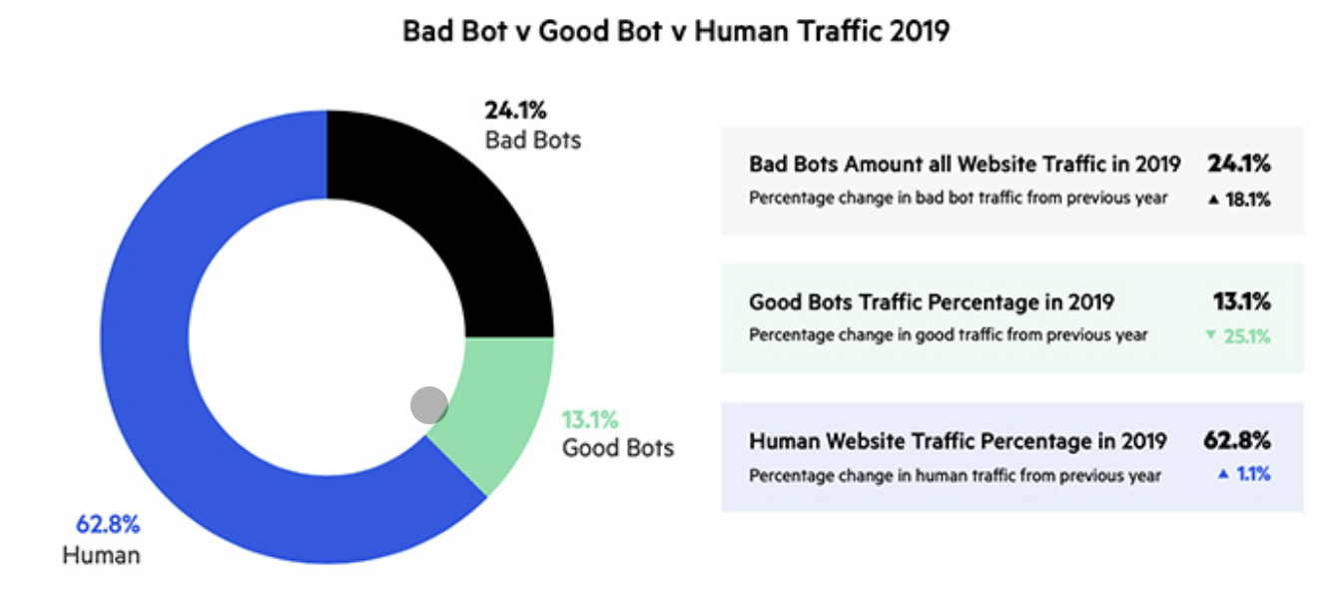
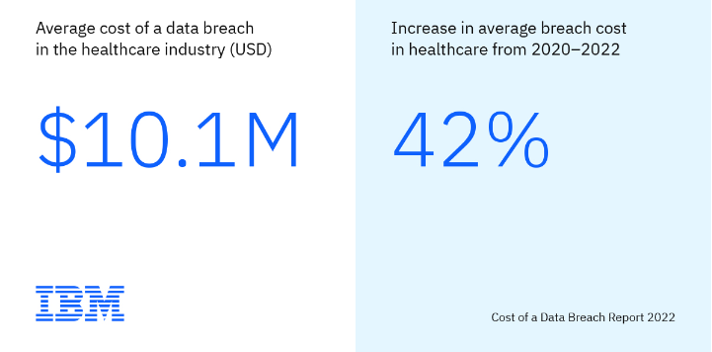
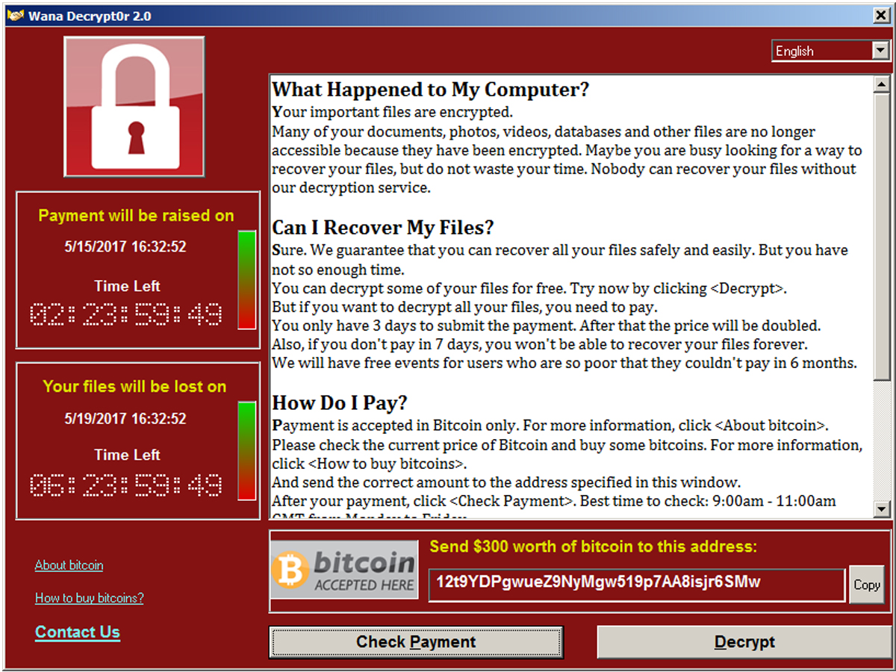
Relevance IT Sicherheit
Distributed Denial of Service (GitHub 2018)
Quellen: https://securityintelligence.com/posts/whats-new-2022-cost-of-a-data-breach-report/ , https://ermetic.com/blog/cloud/ibm-cost-of-a-data-breach-2022-highlights-for-cloud-security-professionals/ , https://www.bitsight.com/blog/cost-of-data-breach

Slide 5
IT Security
“What is IT security? ”

Slide 6
IT Security
“Computer security deals with the prevention and detection of unauthorized actions by users of a computer system.”
Ross J. Anderson: “Security Engineering”, Wiley, 2008

Slide 7
Setting the Scene
How do
we know?
What are we
looking for?
“Computer security deals with the prevention and detection of
unauthorized actions by users of a computer system.”
Ross J. Anderson: “Security Engineering”, Wiley, 2008
What is unauthorized?
Who decides?
What is a system?

Slide 8
Setting the Scence
Security
Protection of assets
Assets: hardware, software, data, information, …
Risks: malware, hackers, info leaks, …
Technical, economical & legal aspects

Slide 9
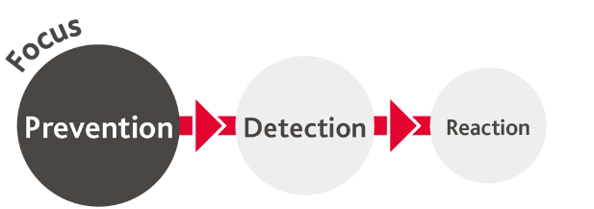
Risk Mitigation Strategies
Protection
Prevention
Measures to prevent assets from being damaged (compromised, modified, ...)
Detection
Measures to reveal and understand damage
Reaction
Measures to recover assets from damage

Slide 10
Delineation to other related areas
Security
Prevention and detection of unauthorized actions in a system
(intelligent) adversary
accidents & external circumstances
Safety
Ensuring the correct behavior of a system
Reliability
Continuity of correct service in the face of system failures
Verification and Validation
e.g. Site Reliability Engineering

Slide 11
IT Security Protection Goals
Security Targets
Confidentiality
Password leaks
Revelation of secret documents Industrial espionage
Protect assets from unauthorized access and information from leakage
Integrity
Protect assets from being modified or irrational
Creation of fake accounts Manipulating databases Interfering automated factory
Availability
Protect asset from downtime
Denial of Service

Slide 12
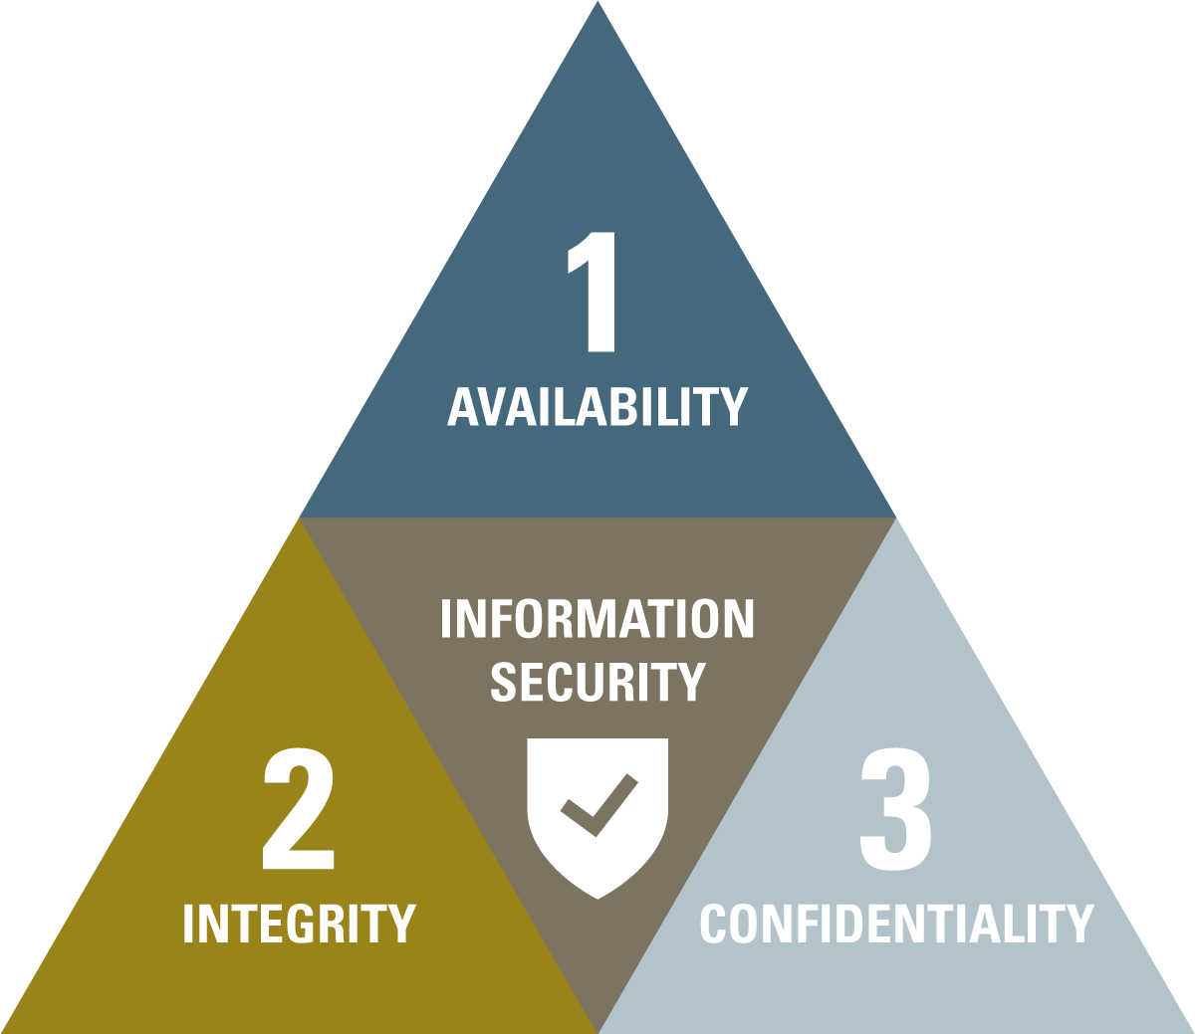
IT Security Protection Goals
Security Targets
Confidentiality
Protect assets from unauthorized access and information from leakage
Integrity
Protect assets from being modified or irrational
Availability
Protect asset from downtime

Slide 13
IT Security Protection Goals
Security Targets – there‘s more…
Accountability
Anonymity
…

Slide 14
Security Threats
„What are threats to information technology?“

Slide 15


Security Threats
Targeted Attacks
Specific target (server, organizations, …)
Attempt to compromise single system
Defined goal:
10%
Disruptive
activity
Intelligence
gathering
90%
data source: Symantec Internet Security Threat Report 2018
6

Slide 16
Security Threats
Targeted Attacks
Specific target (server, organizations, …)
Attempt to compromise single system
Defined goal
Examples: targeted hacking, spear phishing, social engineering, …
Zero-day bugs, Advanced Persistent Threats
multimodality
e-mail

Slide 17
Security Threats
Multi-Targeted Attacks
Multiple targets
Attempt to compromise many (heterogeneous) systems
Automated, e.g., by malware
Manifold goals
Examples: spam, coin-mining, …

Slide 18


Security Threats
Spam
Unsolicited bulk e-mails
Mostly commercial, e.g., pharmacy
Partly malicious, e.g., scams
Legit e-mails
Spam e-mails
45%
55%
data source: Symantec Internet Security Threat Report 2018

Slide 19
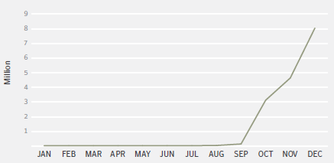
Security Threats
Coin-Mining
Steal computation power to calculate crypto-currency
Many distribution vectors and victims, e.g., IoT devices
Also mobile devices affected
Most common: script-based
Upcoming attack vector
Total coin-mining activity increased by more than 34.000% during 2017
data source: Symantec Internet Security Threat Report 2018

Slide 20
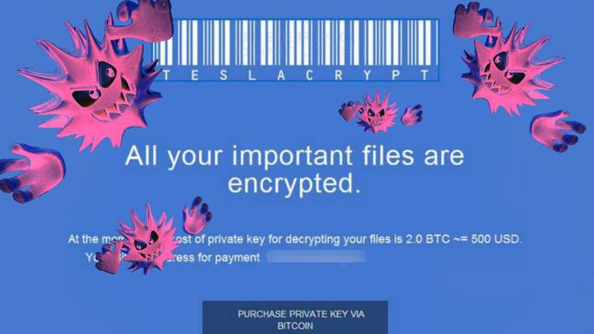
Security Threats
Ransomware
Encrypt victims‘ systems completely
No use of system possible
Decryption key in exchange for money
Blackmailing approach
Malware
Compromises Availability
11

Slide 21
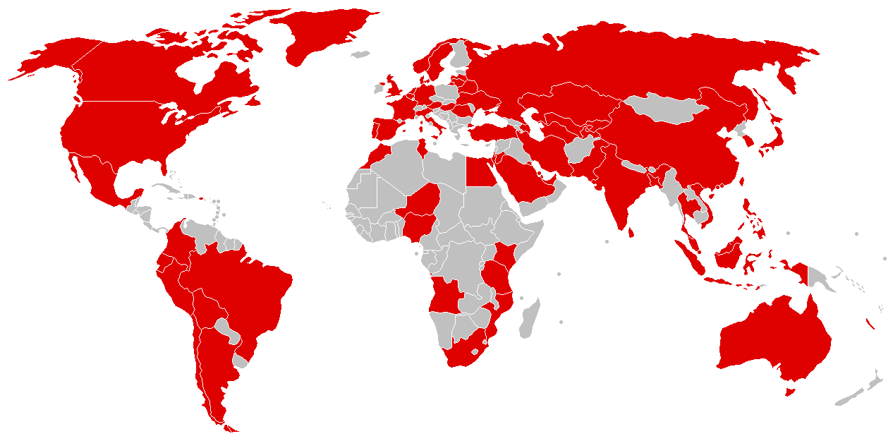
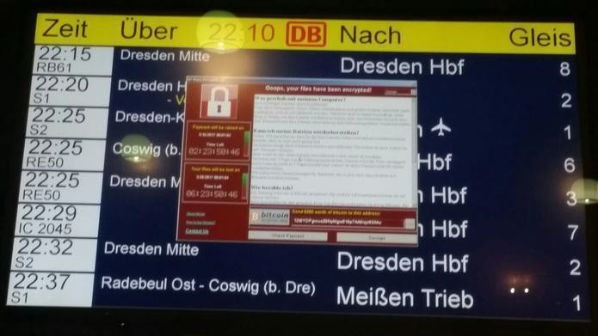
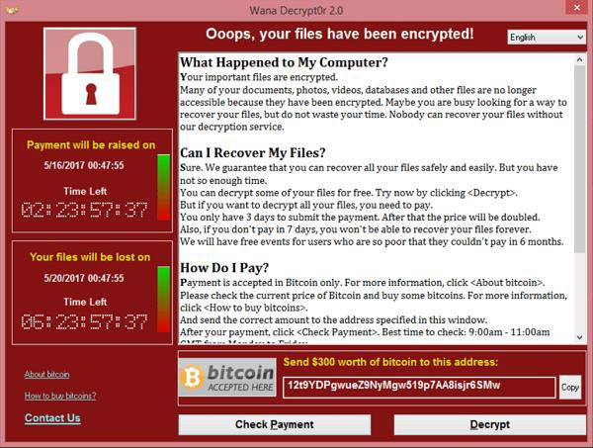
Security Threats
Ransomware: WannaCry
image source: https://en.wikipedia.org/wiki/WannaCry_ransomware_attack
12

Slide 22
Security Threats
Malware
Malicious Software
“software designed to cause damage on purpose”
viruses, worms, Trojan horses, ransomware, spyware, adware, scareware, coin miners, …
13

Slide 23
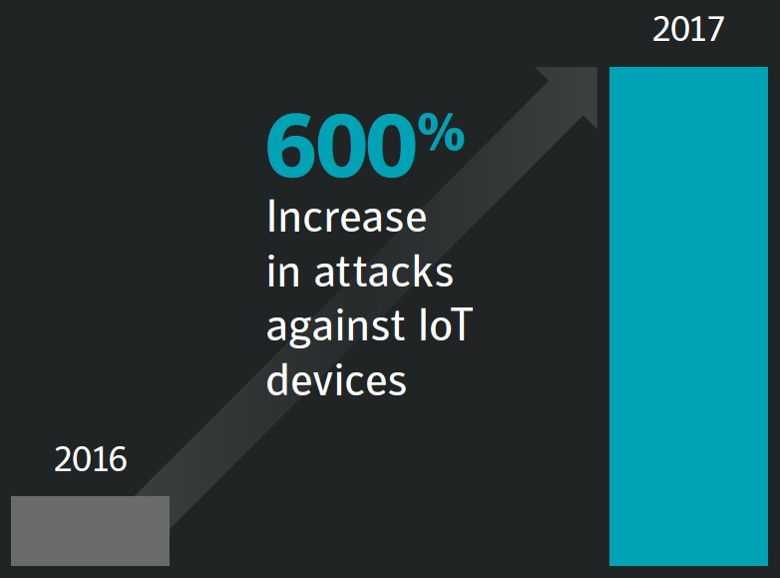
Security Threats
Malware on IoT Devices
Internet of Things: networked „smart“ devices
source: Symantec Internet Security Threat Report 2018
14

Slide 24
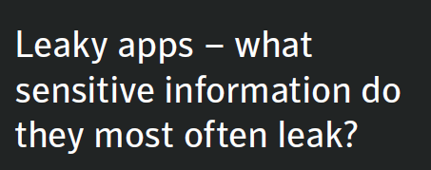


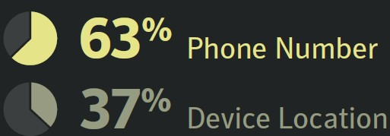
Security Threats
Mobile Malware
~27.000 new malware variants in 2017
Increasing threat since years
Main flaw: old operating systems
Latest
20%
Android
Older Versions
80%
data source: Symantec Internet Security Threat Report 2018
15

Slide 25
Security Threats
Software Bugs
Vulnerability that allows
Unauthorized access
Faulty authentication
Information leakage
Data modification
Caused by
Faulty implementations
Missing use case analyses
Unforeseen circumstances

Slide 26

Security Threats
Heartbleed Bug
Vulnerability in OpenSSL library
Cross-device, cross-OS
High impact, many victims
Canada Revenue Agency leaked Social Security Numbers of 900 citizens
„Catastrophic is the right word. On the scale of 1 to 10, this is an 11.”
- Bruce Schneier

Slide 27
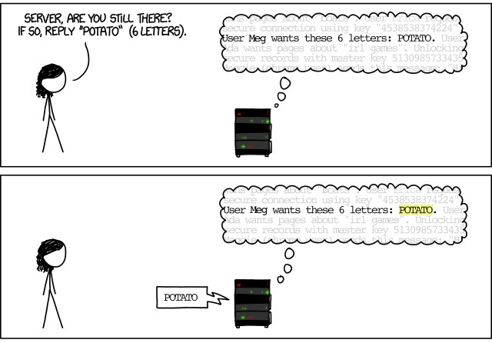
Security Threats
Heartbleed Bug

Slide 28
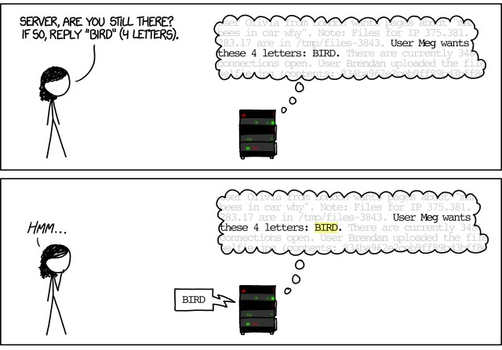
Security Threats
Heartbleed Bug

Slide 29
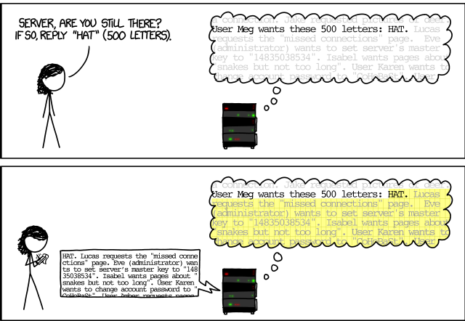
Security Threats
Heartbleed Bug
Missing input validation / sanitization
Lessons learnt about the approach of adversaries: They challenge the (potential) assumptions software engineers may have made
Learn to think in “abuser stories” rather than just in “user stories”
Buffer
over-read

Slide 30
Security Threats
Heartbleed Bug
Vulnerability in OpenSSL library
Cross-device, cross-OS
High impact, many victims
Buffer over-read
Information leakage
Missing input validation
Compromised Confidentiality

Slide 31



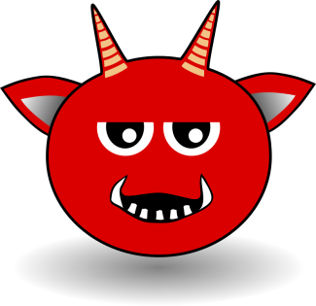

Security Threats
Denial of Service

Slide 32
Security Threats
Denial of Service
Flooding a victim system with requests
Usually several attacker systems
Optional amplification
Main flaw: IP spoofing
Compromises Availabity

Slide 33
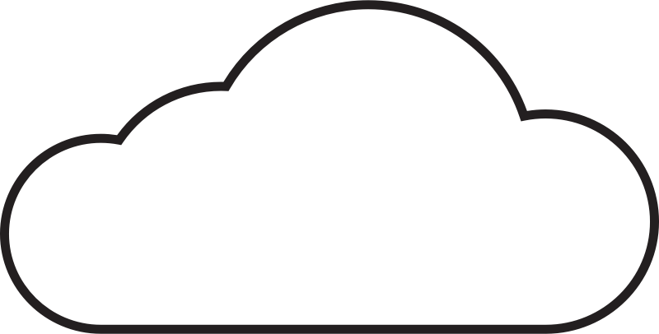


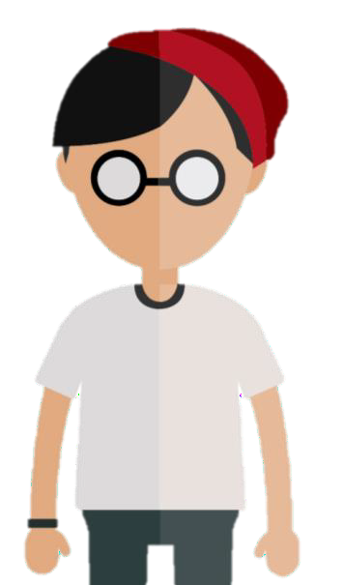
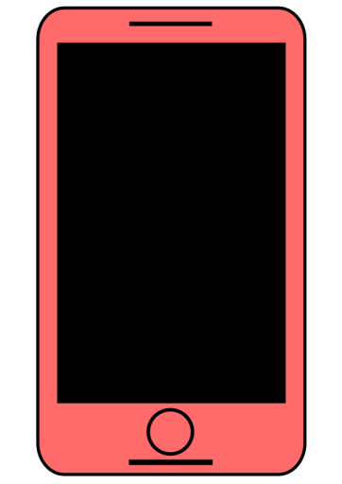
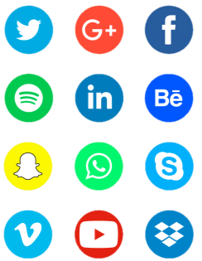
Security Threats
Shadow IT
Admins
IT Service Management
Company
Network
Controlling
Authorized Service
Security Mechanisms
. . .

Slide 34
Security Threats
Shadow IT
Non-company hardware
External IT services
Circumvention of IT infrastructure & processes
Compliance conflicts
Security risks, e.g., malware

Slide 35
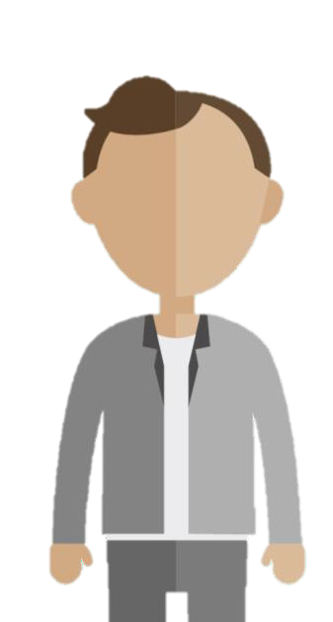
Security Threats
Formjacking
2: provides payment data
during shopping
1: code injection manipulating payment form
webshop
3: retrieves payment data
(credit card data, etc.)
attacker
user

Slide 36
Challenges of IT Security
“What are some examples for hacks? ”

Slide 37
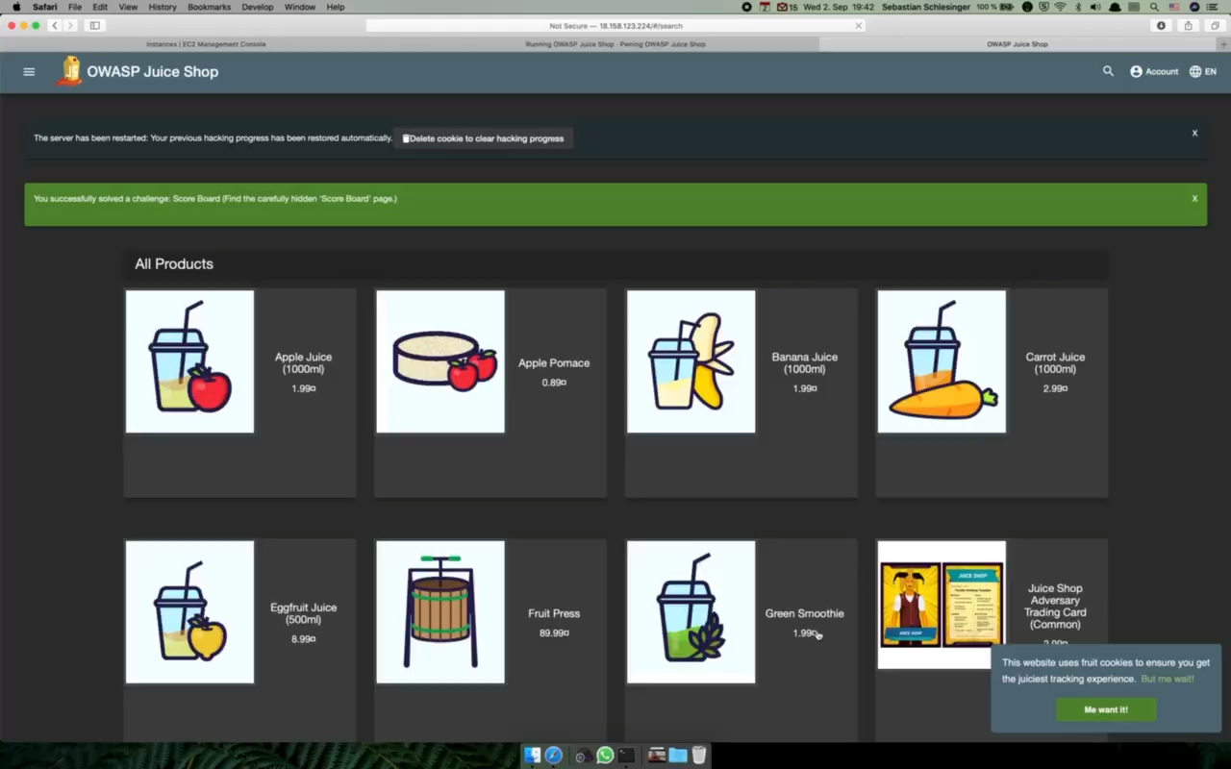
XSS

Slide 38
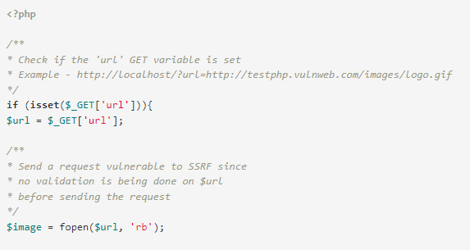
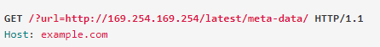
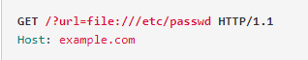
Server-Side Request Forgery (SSRF)
SSRF-vulnerable code
Exploits
Missing input validation
We’ll get to that in the Application Security section

Slide 39
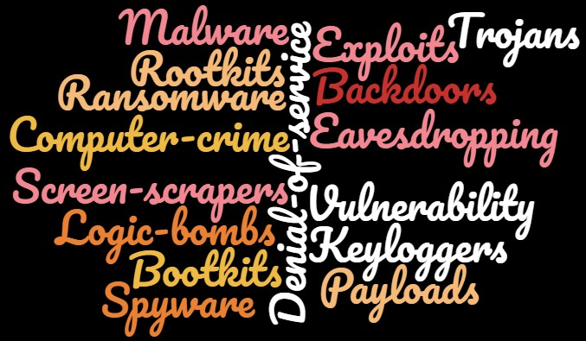
Security Threats

Slide 40
Challenges of IT Security
“Why is Security difficult? ”

Slide 41
Some Challenges
“Security is not important”
“IT Security team prevents instead of enabling”
“Security is a process” (Bruce Schneier)
Security is not tangible and hard to understand
Developers think in terms of user stories, security needs to think in terms of abuser stories
Complexity stack vs. details on lower levels
Each system has specific vulnerabilities (operating systems, applications, programming languages etc.)
Complex systems that interact with each other in manner hard to reproduce
Hard to incorporate into software development lifecycle
Security vs. Usability
Flood of security news
Connectivity
Zero day exploits

Slide 42
Particular Challenges for Network Security
Remote accessibility
Distribution of attacks
(perceived) anonymity
High complexity
Supply Chain Attacks hard to track

Slide 43
Particular Challenges for Embedded Security
Low Level implementation, hard to track security issues
Irregular security updates: either underestimated security threats or due to low bandwidth / decentral application irregular updates
Mass production of embedded devices → attack replication
Dependability / ubiquitousness of embedded devices, particularly for critical infrastructure
Longer device lifecycle compared to traditional IT
…

Slide 44
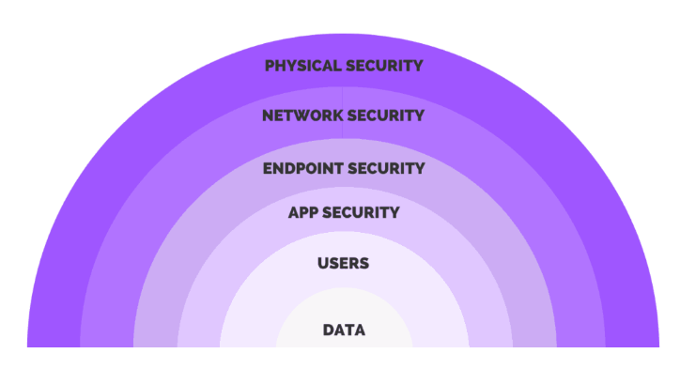
Some general remarks on security
There is no perfect security, every system is hackable
As always, people, processes, and technology are key
People often are the greatest weakness
Security is a company-wide challenge and effort
Security processes happen in iterative cycles – it is often a cat and mouse game
Since there is no silver bullet, security approaches are generally applied in layers, in an onion-like design
Hacking is a lot about trial and error and questioning the assumptions the software engineers have made
We are developing on top of a huge stack of complexity and abstraction; Security has a lot to do with decoupling that complexity and understanding what’s really going on under the hood

Slide 45
Basic terms
Some foundational vocabulary

Slide 46
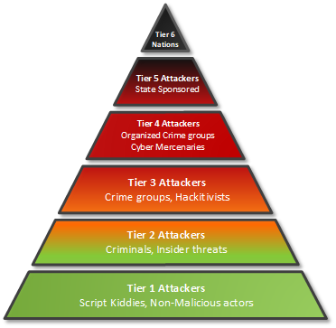
Threats
Any circumstance or event with the potential to adversely impact organizational operations (including mission, functions, image, or reputation), organizational assets, or individuals through an information system via unauthorized access, destruction, disclosure, modification of information, and/or denial of service. Also, the potential for a threat-source to successfully exploit a particular information system vulnerability.
Example
External attacker tries to gain access to sensitive data
Source: NIST glossary

Slide 47
Vulnerability
Weakness in an information system, system security procedures, internal controls, or implementation that could be exploited or triggered by a threat source.
Example
Data in an S3 bucket is unencrypted
Source: NIST glossary

Slide 48
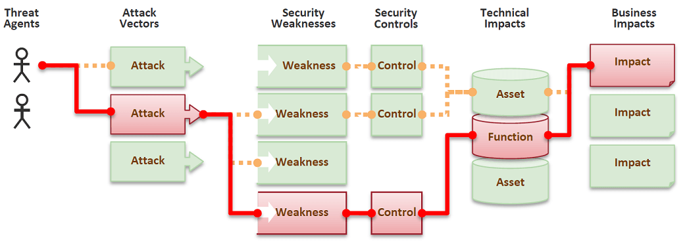
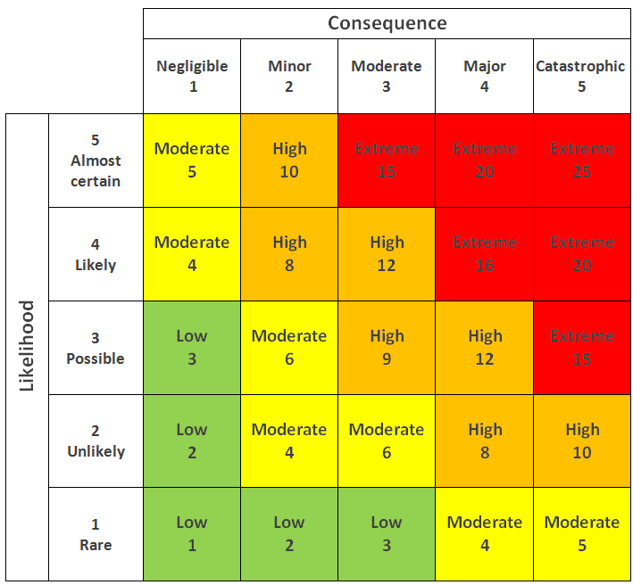
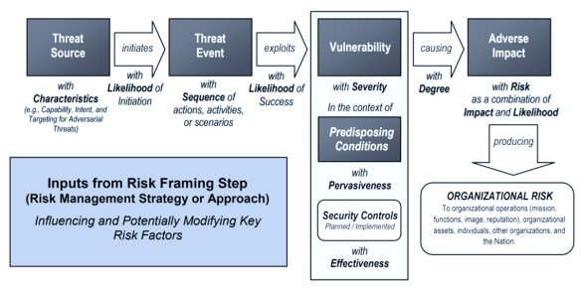
Risk
The level of impact on organizational operations (including mission, functions, image, or reputation), organizational assets, or individuals resulting from the operation of an information system given the potential impact of a threat and the likelihood of that threat occurring.
Source: NIST glossary

Slide 49
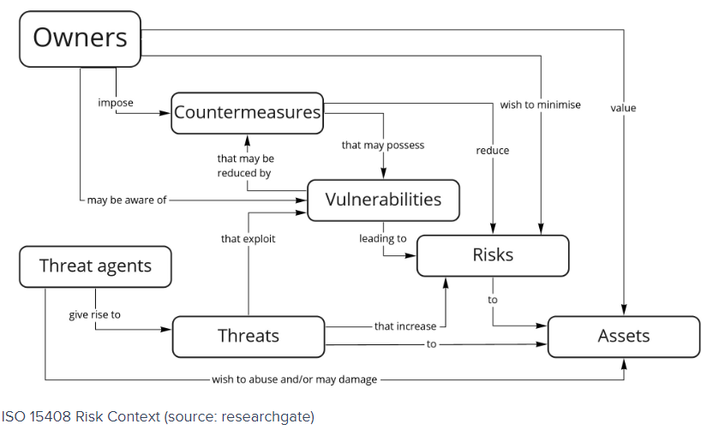
Security Risk Ontology

